Slide 1
Vision control

Slide 2



Project Team
Dr. Wolfgang Werth
MSc. Heinz Liechtenecker
Gregor Fritz
Laurenz Hundgeburth

Slide 3
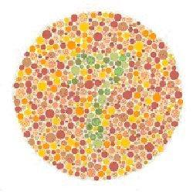
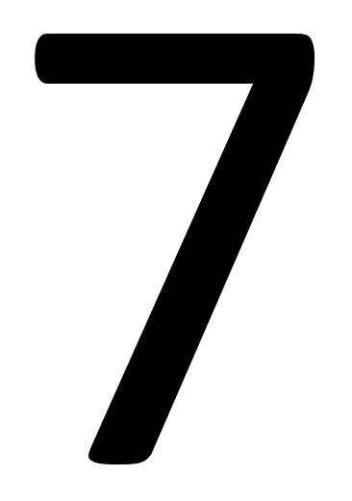
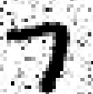
Thought Experiment on Abstraction
Source1: http://www.marcelhaas.com/index.php/author/marcelhaas_em0ahm/
Source2: http://www.uni-koeln.de/~jschween/spiel/farbtafeln/farbtafeln.html

Slide 4
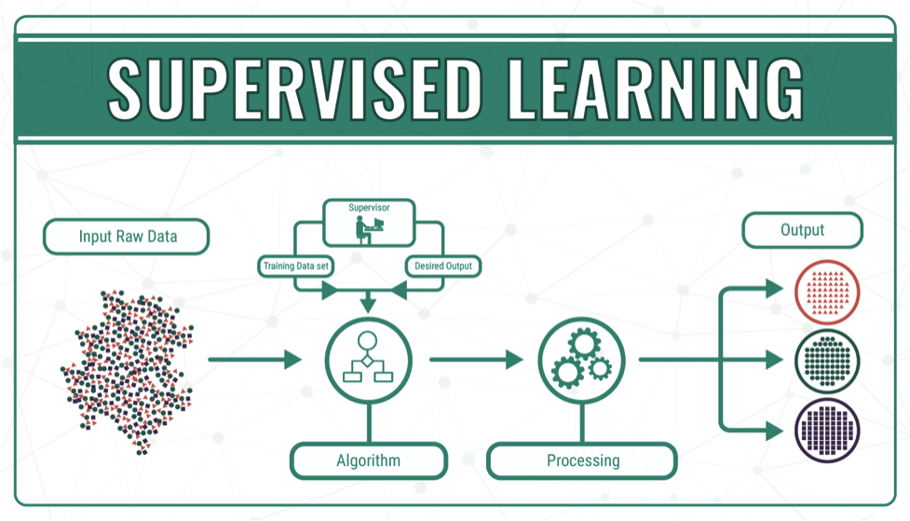
Supervised Learning
Source3: https://medium.com/@himanshuit3036/supervised-learning-methods-using-python-bb85b8c4e0b7

Slide 5
Expected Result

Slide 6
Plan of Work

Slide 7
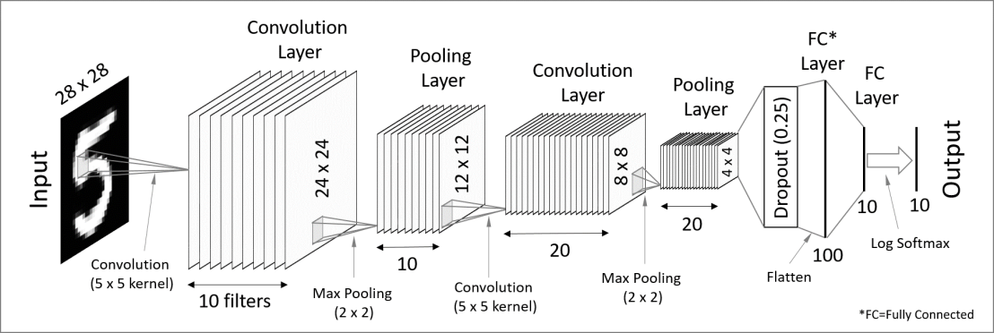
Convolutional Neural Networks
Source 4: https://codetolight.wordpress.com/2017/11/29/getting-started-with-pytorch-for-deep-learning-part-3-neural-network-basics/

Slide 8
Challenges Ahead

Slide 9
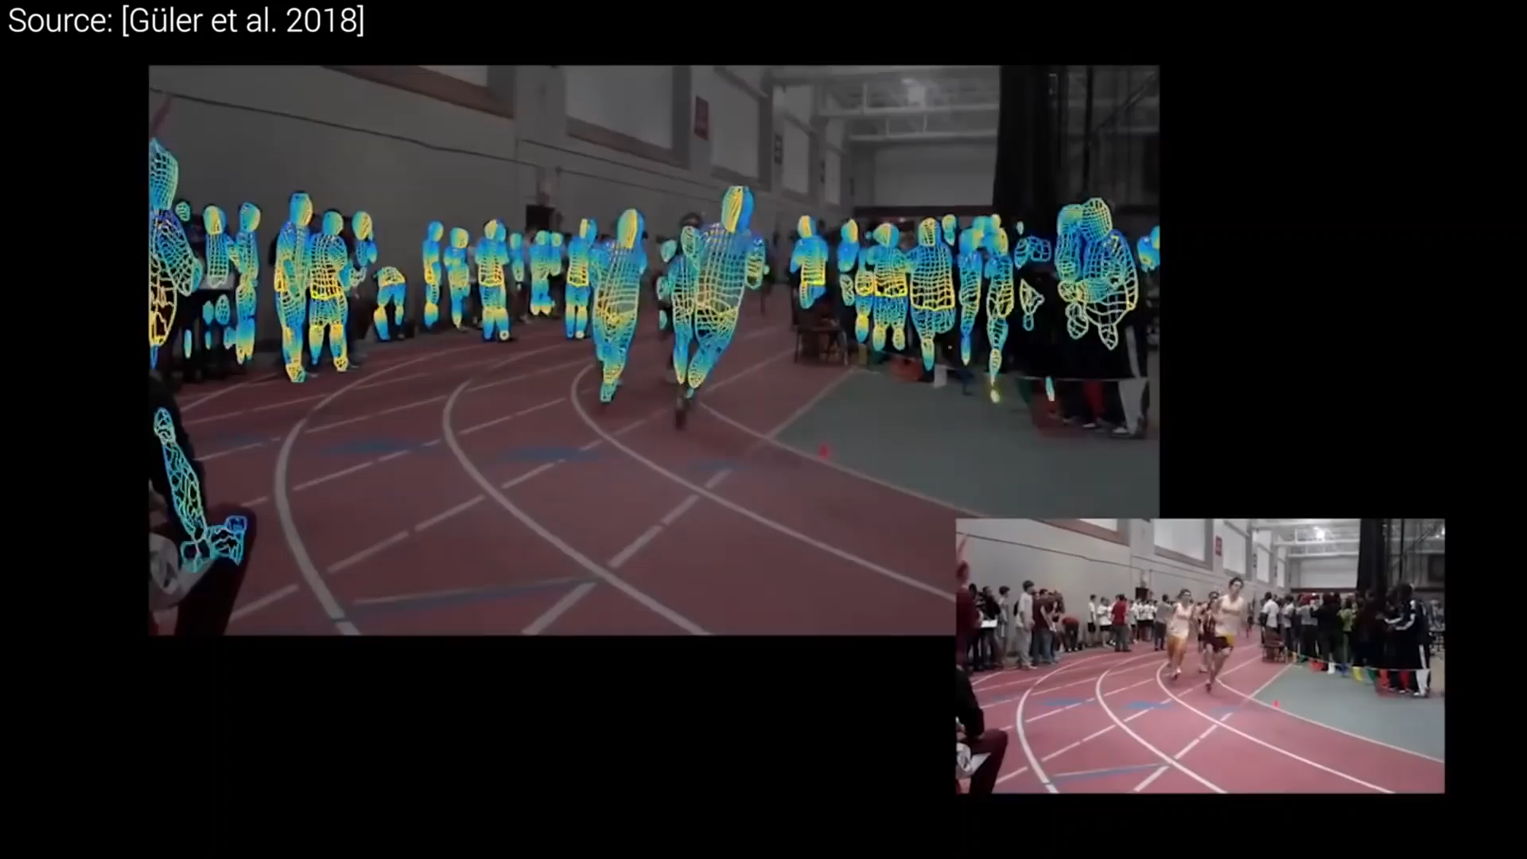
Conclusion
Source5: https://www.youtube.com/watch?v=F84jaIR5Uxc&t=10s

Slide 10
Thank You!

Slide 11
Project Team
Supervisors:
FH-Prof. Dipl.-Ing. Dr. Wolfgang Werth
Heinz-Peter Ulrich Liechtenecker, BSc MSc
Students:
Laurenz Hundgeburth
Gregor Fritz

Slide 12
Source1: http://www.marcelhaas.com/index.php/author/marcelhaas_em0ahm/
Source2: http://www.uni-koeln.de/~jschween/spiel/farbtafeln/farbtafeln.html

